Slide 1
Real Time Network Intrusion Detection System with reduced FAR using Machine Learning
Sampada Pingale
Mrinal Bhalerao
Anjum Pathan
Jyoti Bhole

Slide 2
Index
Introduction
Working
Decision Tree
KNN
Future scope
Conclusion
Results
Future Scope
Introduction
Existing systems
Purpose and usage
Approaches
Concept

Slide 3
Introduction
Definition:
Real-Time Intrusion Detection System (RT-IDS) is a preventive mechanism that gives an alarm signal to the computer user or network administrator for antagonistic activity on the opening session, by inspecting hazardous network activities.

Slide 4
Introduction
Monitors traffic
Looking for suspicious activity, attack or unauthorized activity.
Types:
Host Based
Network Based

Slide 5
Need
Growing rate of attacks, Increasing rate of network activities
Impact on confidentiality and integrity of critical data.
Network systems must use security tools such as firewall, antivirus, IDS to prevent important data from being misused.
Firewall alone is not enough. Since , it cannot defend against intrusion attempts during port opening.
IDS automates the monitoring and analyzing events, to detect malicious or spurious activity

Slide 6
Purpose and Usage
-Confidentiality
-Integrity
-Security
-Prevent Attacks

Slide 7
Approaches
Signature Based
-Patterns of attacks
-Pre-classified signatures
Anomaly Based
-Capture deviated behavior
-Predict anomalies

Slide 8
Concept “Real Time NIDS”
Network
?
NIDS
System
Application
Log File

Slide 9
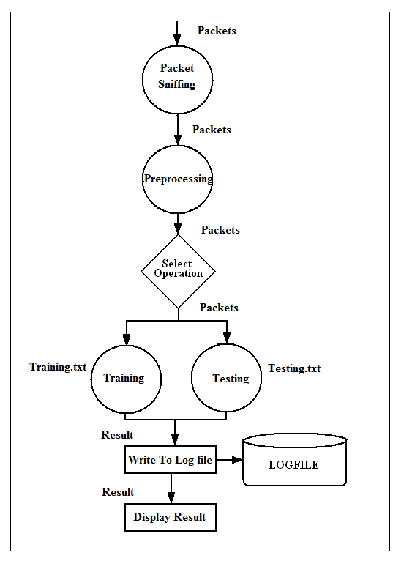
Concept
“Real Time
NIDS”

Slide 10
How is our system different than other systems?
“Real-Time” system
Employs machine learning which improves through experience
Multiple algorithms
Improved results
Performance and efficiency

Slide 11
Index
Introduction
Machine Learning
Decision Tree
KNN
Future scope
Conclusion
Results
Future Scope

Slide 12

Machine learning
Improve through experience
A) Poorly understood problem domains
little knowledge exists for the humans to develop effective algorithms
Or
B) Large databases
valuable implicit regularities to be discovered
Or
C) Changing conditions

Slide 13
Index
Introduction
Working
Decision Tree
KNN
Future scope
Conclusion
Results
Future Scope
Introduction
How they work
Rule Induction
Working
Entropy
Information Gain
Remarks

Slide 14
Decision Tree
Leaf node: Classes
Intermediate node: Range of feature value
It is best algorithm for data classification where :
Features can be extracted
Classification depends on some attributes
Huge amount of data to be classified
Relationship amongst features is unknown
Learning is expected through experience

Slide 15
How They Work ?
Tree partitions samples into mutually exclusive groups
All paths
start at the root node
end at a leaf
Each path represents a decision rule
All paths - mutually exclusive
for any one case - only one path will be followed

Slide 16
Rule Induction
Process of building the decision tree or ascertaining the decision rules
tree induction
rule induction
Decision tree algorithms
from the root (top) down - greedy approach
established basic algorithms include ID3 and C4.5

Slide 17
TCP
ICMP
UDP
<A
<B
<Z
ALARM
Normal
DOS
Probe

Slide 18
Entropy
A measure of homogeneity of the set of examples.
S: set of positive and negative examples of some target concept (a 2-class problem), the entropy of set S relative to this binary classification is
E(S) = - p(P)log2 p(P) – p(N)log2 p(N)

Slide 19
Information Gain
Information gain : expected reduction in entropy/uncertainty.
Values(A) : set of all possible values for attribute A
Sv: subset of S for which attribute A has value v
Sv = {s in S | A(s) = v}.
the first term in the equation for Gain is just the entropy of the original collection S
the second term is the expected value of the entropy after S is partitioned using attribute A

Slide 20
Remarks
Advantages:
Learning through experience
Adaptable
Follows machine learning completely
Huge data classification
Disadvantages:
It is sensitive to train set and noise

Slide 21
Index
Introduction
Working
Decision Tree
KNN
Future scope
Conclusion
References
Introduction
Why k-NN?
When to use k-NN
Algorithm
Working
Examples
Remarks

Slide 22
K-Nearest Neighbor (knn)
Most basic type of instance learning
Assumes all instances are points in n-dimensional space
A distance measure is needed to determine the “closeness” of instances
Classify an instance by finding its nearest neighbors and picking the most popular class among the neighbors

Slide 23
When to consider Nearest Neighbor Algorithm?
Less then 20 attributes per instance
Lots of training data
Advantages:
Training is very fast
Learning complex target functions
Don’t lose information
Disadvantages:
Slow at query

Slide 24
K-Nearest Neighbor Algorithm
Let an arbitrary instances x be described:
x={a₁(x), a₂(x), ..., a_{n}(x)}
The distance between two instances and is defined:

Slide 25
K-Nearest Neighbor Algorithm
Features
All instances correspond to points in an n-dimensional Euclidean space
Classification is delayed till a new instance arrives
Classification done by comparing feature vectors of the different points
Target function may be discrete or real-valued

Slide 26
1-Nearest Neighbor

Slide 27

3-Nearest Neighbor

Slide 28
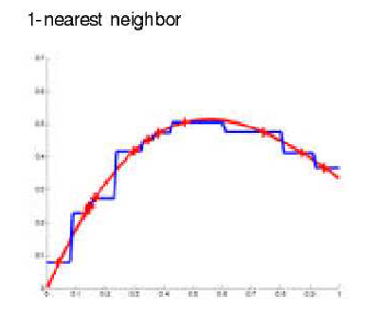
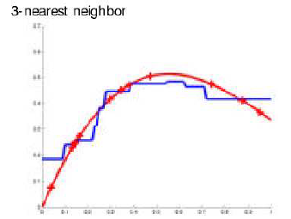
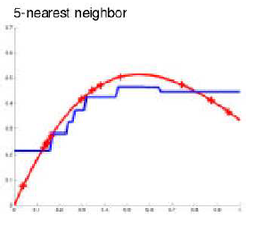
k-Nearest Neighbor Examples

Slide 29
K-Nearest Neighbor
An arbitrary instance is represented by (a₁(x), a₂(x), a₃(x),.., a_{n}(x))
Euclidean distance between two instances
Continuous valued target function
mean value of the k nearest training examples

Slide 30
K-Nearest Neighbor Algorithm Steps
Training Algorithm:
Store all training examples <x, f(x)>
Classification Algorithm:
Given a instance x_{q} to be classified,
Let x₁, … x_{k} denote the k instances from the list of training examples
Return
(for discrete-valued target function)
where δ(a,b)=1 if a=b and where δ(a,b)=0 otherwise

Slide 31
Remarks
Highly effective inductive inference method for noisy training data and complex target functions
Target function for a whole space may be described as a combination of less complex local approximations
Learning is very simple
Classification is time consuming

Slide 32
Index
Introduction
Working
Decision Tree
KNN
Working
Conclusion
Results
Future Scope
Preprocessing
Classification
Post Processing
Reducing FAR

Slide 33
Working Procedure
Step I : Preprocessing
Packet capturing:
-Wireshark (Ethereal)
-Capsa

Slide 34
Working Procedure
Step II : Classification
Training
-With answer class
Testing
-Without answer class

Slide 35
Working Procedure
Step III : Post processing
Measuring system performance:
CASE | Expected Answer | Answer Obtained | Outcome
True Positive | ALARM | ALARM | Desirable
True Negative | NORMAL | NORMAL | Desirable
False Positive | ALARM | NORMAL | Not Desirable
False Negative | NORMAL | ALARM | Not Desirable

Slide 36
Working Procedure
Step IV : Reducing False Alarms
Majority voting algorithm
-E.g. at least 3 out-of 5 records reported to be attack, then it is considered the attack. Else, it is considered as normal.
Increase Detection Accuracy

Slide 37
Index
Introduction
Working
Decision Tree
KNN
Working
Conclusion
Results
Future Scope
1.Advantages
2.Disadvantages
3.Applications
4.Conclusion

Slide 38
Advantages
Gives Security to data
Less Hardware Dependency
Constant Network Monitoring
Versatility of the System
Use of 2 different algorithms making it improve performance
Machine learning technology making it update itself

Slide 39
Disadvantages
Performance can not be guaranteed as the problem is NP hard
Packet Sniffing tool is necessary

Slide 40
Applications
Intrusion Prevention System
Protocol Based Intrusion detection system
Security tools
Firewall

Slide 41
Conclusion
We have used different machine learning algorithms to model Intrusion Detection System (IDS) to improve detection rate and reduce False Alarm Rate (FAR).
With the help of k-NN and Decision Tree.

Slide 42
Index
Introduction
Working
Decision Tree
KNN
Future scope
Conclusion
Results
Future Scope
Results
Screenshots

Slide 43
Index
Introduction
Working
Decision Tree
KNN
Future scope
Conclusion
Results
Future Scope

Slide 44
Future Scope
Improved rate of detection.
Use more Machine Learning Algorithms to improve accuracy.
Use the system for detecting new attacks.

